Slide 1
Lecture – 26-27
Binary Files

Slide 2
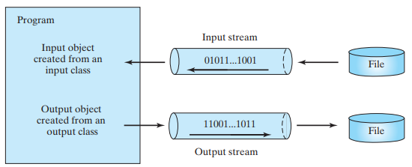
How is I/O Handled in Java?
A File object encapsulates the properties of a file or a path, but does not contain the methods for reading/writing data from/to a file.
In order to perform I/O, you need to create objects using appropriate Java I/O classes.
Scanner input = new Scanner(new File("temp.txt"));
System.out.println(input.nextLine());
PrintWriter output = new PrintWriter("temp.txt");
output.println("Java 101");
output.close();

Slide 3
Text File vs. Binary File
Binary I/O does not involve encoding or decoding and thus is more efficient than text I/O.
Data stored in a text file are represented in human-readable form.
Data stored in a binary file are represented in binary form. You cannot read binary files.
Binary files are designed to be read by programs.
  For example, the Java source programs are stored in text files and can be read by a text editor, but the Java classes are stored in binary files and are read by the JVM.
  The advantage of binary files is that they are more efficient to process than text files.

Slide 4
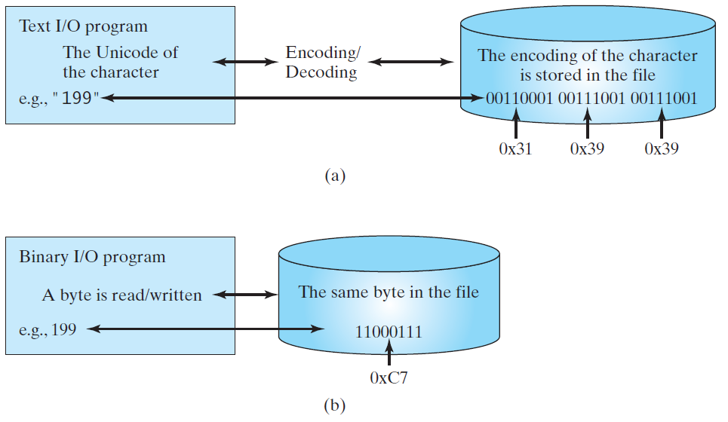
Binary I/O
Text I/O requires encoding and decoding.
The JVM converts a Unicode to a file specific encoding when writing a character and converts a file specific encoding to a Unicode when reading a character.
Binary I/O does not require conversions. When you write a byte to a file, the original byte is copied into the file. When you read a byte from a file, the exact byte in the file is returned.

Slide 5
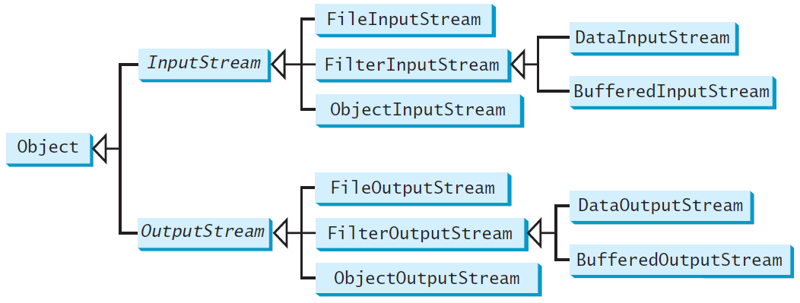
Binary I/O Classes
The abstract InputStream is the root class for reading binary data, and the abstract OutputStream is the root class for writing binary data

Slide 6
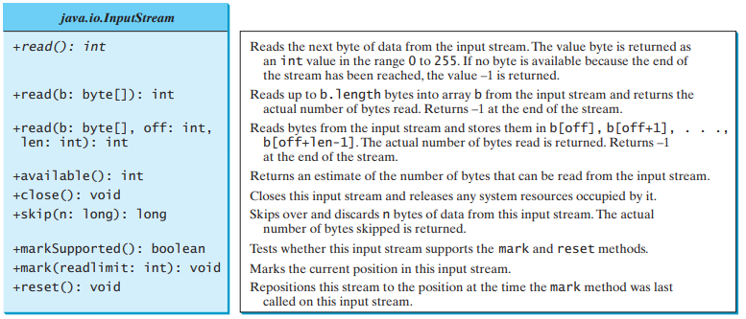
InputStream

Slide 7
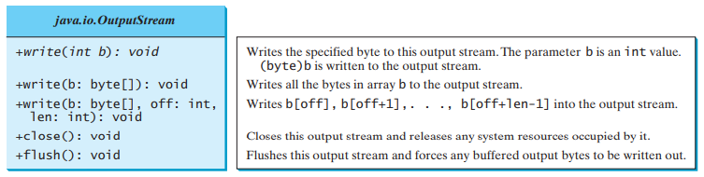
OutputStream

Slide 8
FileInputStream/FileOutputStream
FileInputStream/FileOutputStream associates a binary input/output stream with an external file.
All the methods in FileInputStream/FileOuptputStream are inherited from its superclasses.
Does not introduce new methods

Slide 9
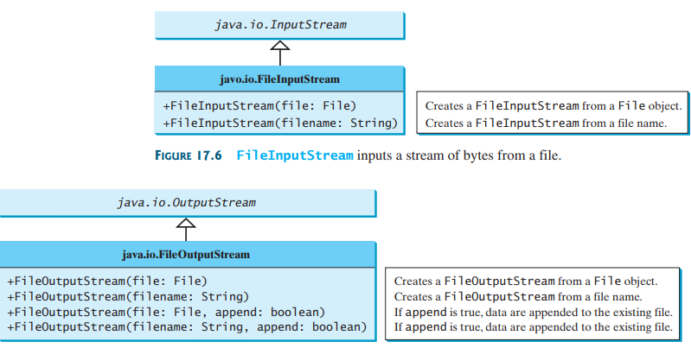
FileInputStream

Slide 10
FileOutputStream
If the file does not exist, a new file would be created.
If the file already exists, the first two constructors would delete the current contents in the file.
To retain the current content and append new data into the file, use the last two constructors by passing true to the append parameter.

Slide 11
Example
import java.io.*;
public class TestFile{
public static void main(String[] args) throws IOException{
FileOutputStream output = new FileOutputStream("temp.dat");
for(int i=0; i<10; i++){
output.write(i);
}
output.close();
FileInputStream input = new FileInputStream("temp.dat");
int value;
while((value = input.read())!= -1)
System.out.println(value + " ");
}
}

Slide 12
Object I/O
DataInputStream/DataOutputStream enables you to perform I/O for primitive type values and strings.
ObjectInputStream/ObjectOutputStream enables you to perform I/O for objects in addition for primitive type values and strings.

Slide 13
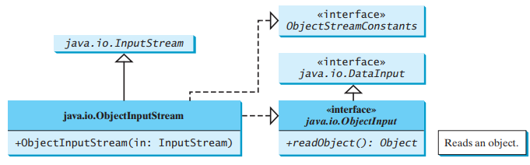
ObjectInputStream
ObjectInputStream extends InputStream and implements ObjectInput and ObjectStreamConstants.

Slide 14
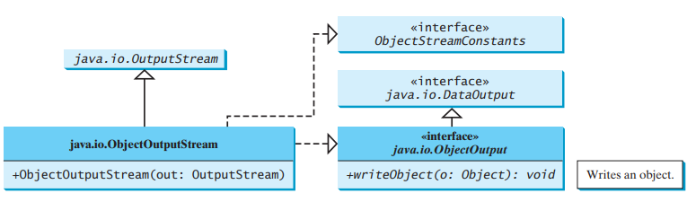
ObjectOutputStream
ObjectOutputStream extends OutputStream and implements ObjectOutput and ObjectStreamConstants.

Slide 15
Using Object Streams
You may wrap an ObjectInputStream/ObjectOutputStream on any InputStream/OutputStream using the following constructors:
  // Create an ObjectInputStream
  public ObjectInputStream(InputStream in)
  // Create an ObjectOutputStream
  public ObjectOutputStream(OutputStream out)

Slide 16
Example
import java.io.*;
public class ObjectStream{
public static void main(String[] args)throws IOException, ClassNotFoundException{
ObjectOutputStream output = new ObjectOutputStream(new FileOutputStream("temp1.dat"));
output.writeUTF("Ali");
output.writeDouble(85.5);
output.writeObject(new java.util.Date());
output.close();
ObjectInputStream input = new ObjectInputStream(new FileInputStream("temp1.dat"));
String name = input.readUTF();
double score = input.readDouble();
java.util.Date date = (java.util.Date)(input.readObject());
System.out.println(name+" "+score+" "+ date);
input.close();
}
}

Slide 17
Using Object Streams
readObject() may throw ClassNotFoundException
  JVM restores an object by first loading the class for the object.
You have to read the data from the file in the same order and format as they were written to the file.

Slide 18
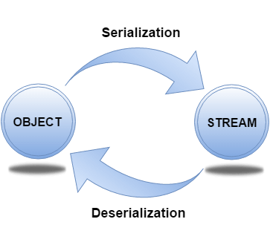
The Serializable Interface
Serialization in Java is a mechanism of writing the state of an object into a byte-stream
The reverse operation of serialization is called deserialization where byte-stream is converted into an object
The serialization and deserialization process is platform-independent,
  Object can be serialized on one platform and deserialize it on a different platform.
import java.io.Serializable

Slide 19
The Serializable Interface
The Serializable interface is a marker interface
  It has no data member and method
The Serializable interface must be implemented by the class whose object needs to be persisted.
The String class and all the wrapper classes implement the java.io.Serializable interface by default.
java.math.BigInteger, java.math.BigDecimal, java.lang.String, java.lang.StringBuilder, java.lang.StringBuffer, java.util.Date, and java.util.ArrayList
All implement Serializable interface

Slide 20
The Serializable Interface
When a serializable object is stored, the class of the object is encoded; this includes
  class name
  signature of the class,
  values of the object’s instance variables, and
  the closure of any other objects referenced by the object
The values of the object’s static variables are not stored

Slide 21
Example of Serialization
import java.io.Serializable;
public class Student implements Serializable{
  int id;
  String name;
  public Student(int id, String name) {
    this.id = id;
    this.name = name;
  }
}
import java.io.*;
class Persist{
public static void main(String args[]){
try{
  Student s1 =new Student(211, “Ali”);
  FileOutputStream fout=new FileOutputStream("f.txt");
  ObjectOutputStream out=new ObjectOutputStream(fout);
  out.writeObject(s1);
  out.flush();
  out.close();
  System.out.println("success");
}catch(Exception e){System.out.println(e);}
}
}

Slide 22
Example of Deserialization
import java.io.*;
class Depersist{
  public static void main(String args[]){
    try{
      ObjectInputStream in=new ObjectInputStream(new FileInputStream("f.txt"));
      Student s=(Student)in.readObject();
      System.out.println(s.id+" "+s.name);
      in.close();
    }catch(Exception e){System.out.println(e);}
  }
}

Slide 23
Serialization Rules
Java Serialization with Inheritance
  If a Parent class implements Serializable interface then all its sub classes will also be serializable
Java Serialization with Aggregation
  If a class has a reference to another class, all the references must be Serializable otherwise serialization process will not be performed
  In such case, NotSerializableException is thrown at runtime.
Java Serialization with array or collection
  In case of array or collection, all the objects of array or collection must be serializable. If any object is not serializable, serialization will be failed.

Slide 24
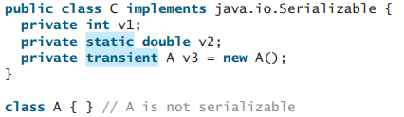
Serialization
Nonserializable fields
  If an object is an instance of Serializable but contains nonserializable instance data fields, can it be serialized?
  The answer is no.
  To enable the object to be serialized, mark these data fields with the transient keyword to tell the JVM to ignore them when writing the object to an object stream
When an object of the C class is serialized, only variable v1 is serialized. Variable v2 is not serialized because it is a static variable, and variable v3 is not serialized because it is marked transient. If v3 were not marked transient, a java.io.NotSerializableException would occur

Slide 25
Serialization
Duplicate objects
  If an object is written to an object stream more than once, will it be stored in multiple copies?
  No, it will not.
  When an object is written for the first time, a serial number is created for it. The JVM writes the complete contents of the object along with the serial number into the object stream. After the first time, only the serial number is stored if the same object is written again. When the objects are read back, their references are the same since only one object is actually created in the memory

